Slide 1
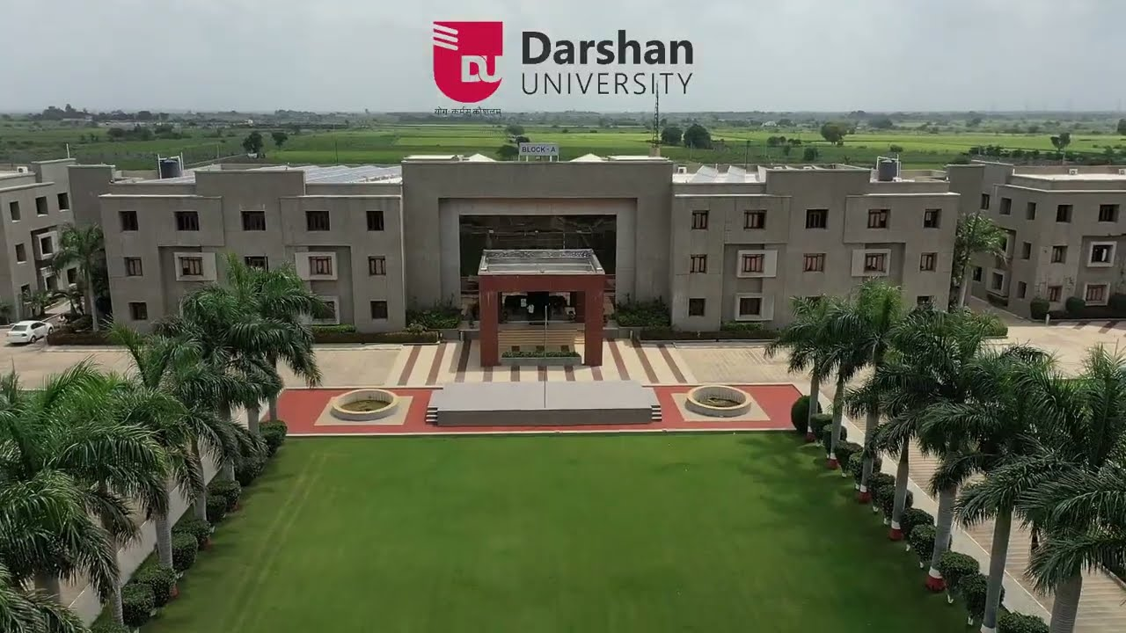
darshan university
Urvashi Zinzuvadiya

Slide 2
About Darshan University
Darshan University is a prominent institution offering undergraduate, postgraduate and doctoral programs.
It offers programs in Engineering & Technology, Science, Management and Yoga.
The institution was initially established as an Engineering Institute in 2009.
It was established by Shree G. N. Patel Education & Charitable Trust.
Darshan University was established under the Gujarat State Private Universities (Amendment) Act, 2021.
The university is located near Rajkot, Gujarat.
It focuses on quality education, innovation, skill development and holistic development.

Slide 3
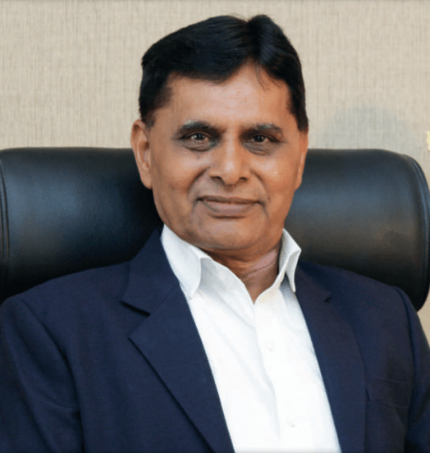

Administrative Leadership
Dr. Ramnik G. Dhamsaniya
President / senior university leadership
Provides strategic direction and leadership to the university.
Prof. Manish V. Sanghani
Executive / administrative leadership
Contributes to academic and institutional development.

Slide 4
Academic Leadership
Academic Leadership
Academic leadership plays an important role in maintaining the quality of education.
It supports curriculum development and academic planning.
It promotes innovation, research and skill-based learning.
Faculty members are encouraged to participate in teaching, training and professional development.
The university focuses on creating a collaborative academic environment.

Slide 5
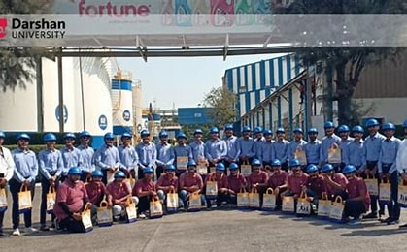
University Authority
Board of Studies (BoS) – Mechanical Engineering
Board of Studies is responsible for academic planning and curriculum-related activities.
It helps maintain academic standards in the department.
It contributes to curriculum design and improvement.
It provides academic guidance according to industry and educational requirements.

Slide 6
Programs Offered
Programs Offered at Darshan University
Diploma Engineering
Undergraduate Engineering Programs
Postgraduate Programs
Science Programs
Management Programs
Yoga Programs
Other professional and academic programs
Diploma Engineering – After 10th
Diploma Engineering programs are available for students after completion of 10th standard.
These programs provide technical and practical knowledge.
Students can develop industry-oriented technical skills.

Slide 7
Why Darshan University?
Why Darshan University?
Quality education
Skill-based learning
Experienced faculty
Modern laboratories and infrastructure
Industry-oriented curriculum
Research and innovation opportunities
Career guidance and placement support
Technical and professional development
Focus on holistic development
Collaborative learning environment
The university states that its academic environment encourages creativity, technical skills and innovation.

Slide 8
Scholarships
Scholarships at Darshan University
MYSY – Mukhyamantri Yuva Swalamban Yojana
Eligibility: 80 or more percentile in 10th / 12th examination.
Family income should be less than ₹6 lakh per annum.
Degree Engineering: Up to ₹50,000 or 50% of tuition fees, whichever is less.
Diploma Engineering: Up to ₹25,000 or 50% of tuition fees, whichever is less.
Scholarships for SC/ST Students
Student must belong to SC or ST category.
Family income should be less than ₹2.5 lakh per annum.
Scholarship is approximately 100% of tuition fees, as per government norms.
🔗 Hyperlink:
Scholarships → Darshan University Scholarships

Slide 9
Computer Department Placement: Last 3 Years
Academic Year | Registered | Placed | Placement % | Highest Package
2024-25 | 172 | 161 | 93.6% | 7.00 LPA
2025-26 | 291 | 277 | 95.2% | 10.00 LPA

Slide 10
Computer Department Placement 2024
Placement Record – 2024
Registered Students: 167
Placed Students: 160
Placement Rate: 95.81%
Highest Package: ₹30.00 Lakh
Average Package: ₹4.65 Lakh
Companies Visited: 68
Average Package – Top 60 Students: ₹6.25 Lakh

Slide 11
Placement Summary
Placement Summary
Darshan University's placement cell works as a bridge between employers and students. It also conducts career guidance programs to help students understand career opportunities.
Branch-wise Placement Summary
You can present:
Computer Science & Engineering
Mechanical Engineering
Civil Engineering
Electrical Engineering
Other Engineering / Professional Programs
2025 / Latest Placement Information
For the CSE program, the official page currently reports:
Registered: 172
Placed: 161
Placement Rate: 93.6%
🔗 Hyperlink:
Placement Summary | Darshan University, Rajkot

Slide 12
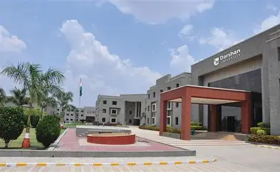
Thank you
Urvashi Zinzuvadiya

